Slide 1
CRIME AND REAL ESTATE IN METRO ATLANTA
RACHEL POULOS, DANIELLE WEEKS, ERIC ROBERTS

Slide 2
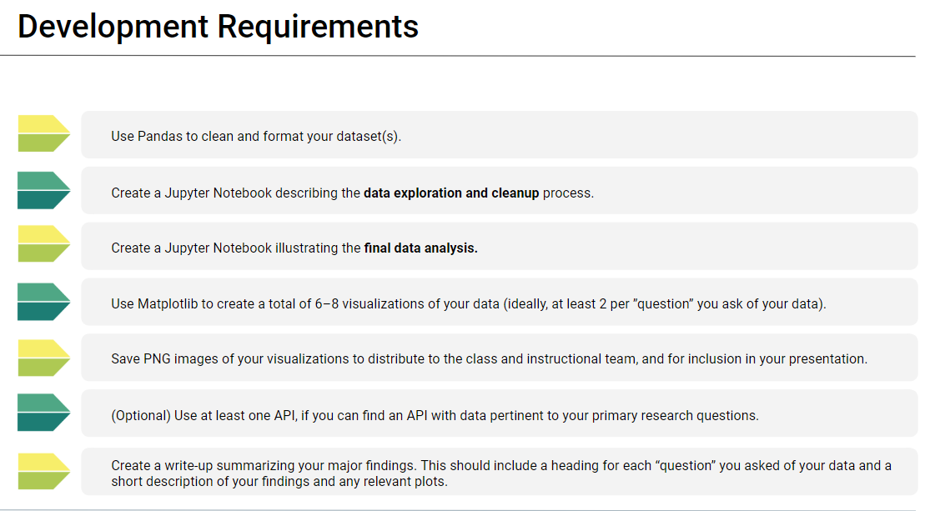
Background

Slide 3
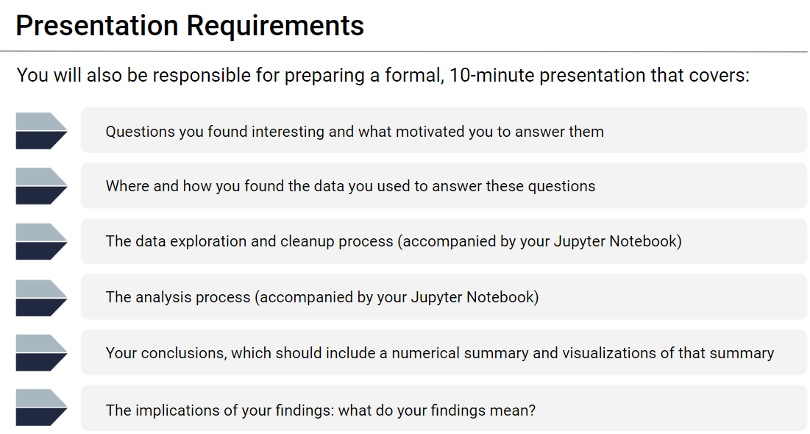
Background

Slide 4


PROJECT PURPOSE & HYPOTHESIS
Is there a correlation between crime and real estate values in Metro Atlanta?
Is crime trending upwards or downwards in lower priced neighborhoods?
Is crime trending upwards or downwards in higher priced neighborhoods?
Notes:
Motivation & Summary Slide
Define the core message or hypothesis of your project.
Describe the questions you asked, and why you asked them
Describe whether you were able to answer these questions to your satisfaction, and briefly summarize your findings

Slide 5
DATA AND BACKGROUND
Background
Atlanta divides itself into more than 230 different logical “neighborhoods”
We analyzed several databases to find answers:
Crime Statistics by Neighborhood, reported by Atlanta Police Department. This database contains every crime reported to APD for several years.
Real Estate Values by a real estate website, Niche.com. We started with Zillow but there it was not suitable to the task. Niche.com has no API; it was necessary to use Web Scraping to get the price data for a given neighborhood.
US Census Data from 2010 showing population for given neighborhoods.
Combining three separate databases provides insights into geographical crime, crime per capita, crime per real estate value
Metro Atlanta Geography API to determine neighborhood boundaries
Notes:
Questions & Data
Elaborate on the questions you asked, describing what kinds of data you needed to answer them, and where you found it

Slide 6
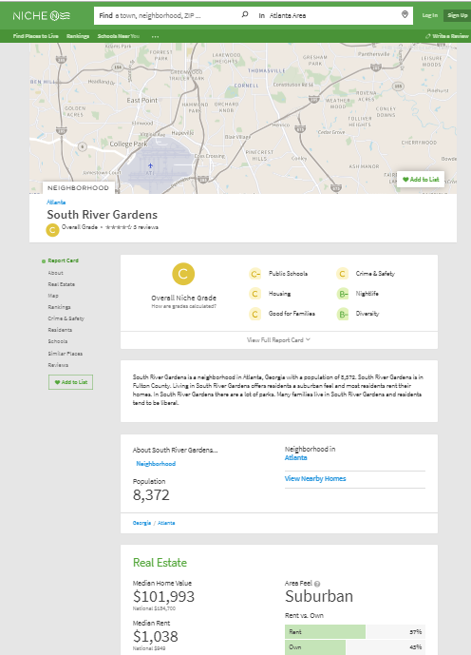
REAL ESTATE PRICES BY NEIGHBORHOOD
For a given neighborhood...
Starting from a database of crime statistics, which includes a neighborhood column, it’s easy to get a list of unique values for the neighborhood using pandas techniques.
We noticed Niche.com’s webmaster uses a predictable format for their URLs:
Midtown: https://www.niche.com/places-to-live/n/midtown-atlanta-ga/
South River Gardens:
https://www.niche.com/places-to-live/n/south-river-gardens-atlanta-ga/
Steps are:
Build a list of URLs
Act like a web browser and fetch each HTML page into memory
Use Beautiful Soup to find the median home value
Put that into a Pandas dataframe
...we want this

Slide 7
DATA EXPLORATION AND CLEANUP
Zip Code and NPU failures
Unable to find year over year sales data for Fulton County housing prices
Zillow’s lack of relevant data on neighborhood level
Census data at the Neighborhood level only existed as recent as 2010
Eliminating Null Values when combining Census Data with Neighborhood Median Home Values due to grouping of neighborhoods in some NPUs (Screenshot – Next Slide)
Notes:
Data Cleanup & Exploration
Describe the exploration and cleanup process
Discuss insights you had while exploring the data that you didn't anticipate
Discuss any problems that arose after exploring the data, and how you resolved them
Present and discuss interesting figures developed during exploration, ideally with the help of Jupyter Notebook

Slide 8
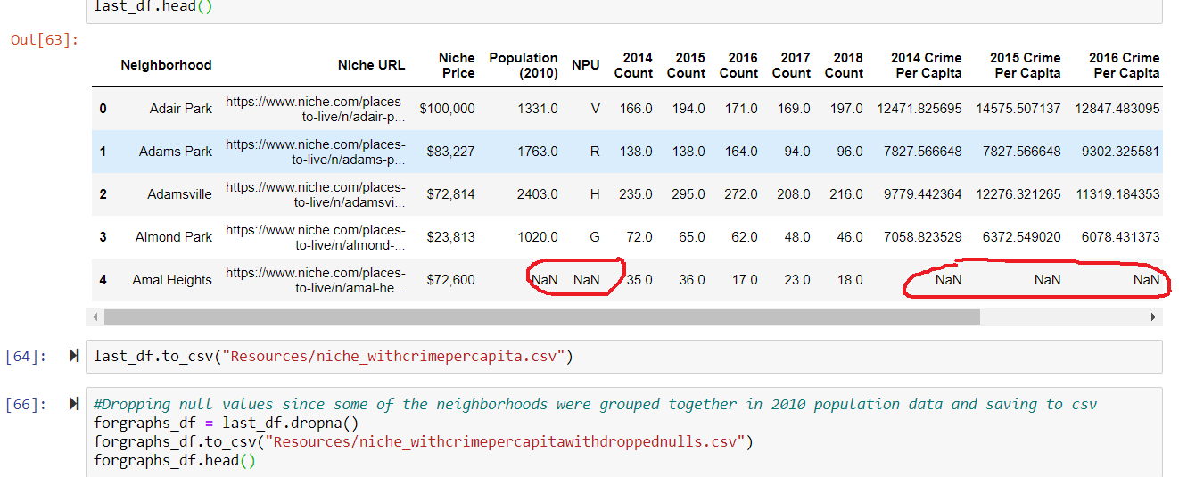
DATA EXPLORATION AND CLEANUP

Slide 9
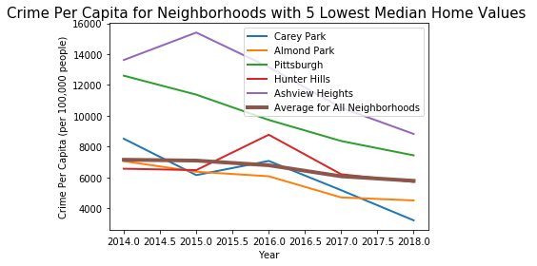
ANALYSIS PROCESS
Steps are:
Used loc method to isolate crime data by year
Value_count by Neighborhood to get crime incident count per neighborhood for each year’s dataframe
Merged dataframes with Eric’s Niche Price dataframe and with the population data
Use loc again to pull 5 neighborhoods with lowest median home value
Took an average of the crime count for all neighborhoods in original dataframe for comparison
Findings:
Downward trend for lowest 5 neighborhoods
Two neighborhoods with crime rates well above average for all
Notes:
Data Analysis
Discuss the steps you took to analyze the data and answer each question you asked in your proposal
Present and discuss interesting figures developed during analysis, ideally with the help of Jupyter Notebook

Slide 10
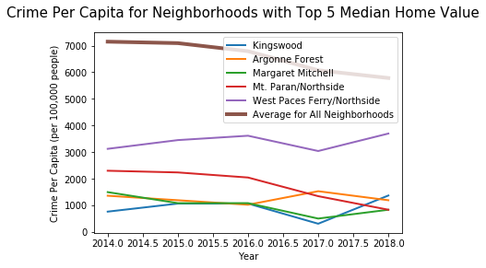
ANALYSIS PROCESS
Steps are:
Same process
Findings:
Five highest priced neighborhoods had crime rates well below average
No consistency in upward/downward trend
Notes:
Data Analysis
Discuss the steps you took to analyze the data and answer each question you asked in your proposal
Present and discuss interesting figures developed during analysis, ideally with the help of Jupyter Notebook

Slide 11
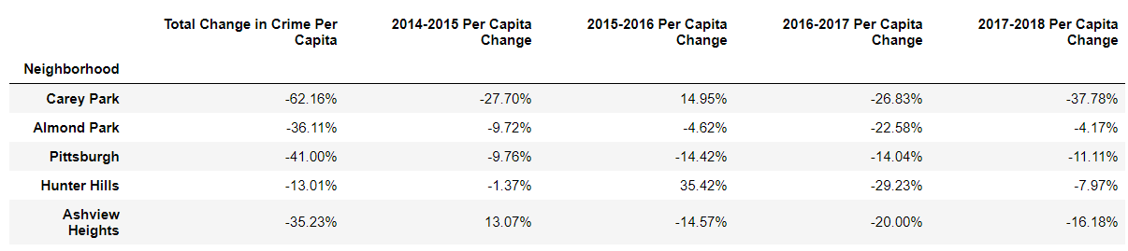
SUMMARY TABLE FOR TOP 5 LEAST EXPENSIVE NEIGHBORHOODS
Notes:
Data Analysis
Discuss the steps you took to analyze the data and answer each question you asked in your proposal
Present and discuss interesting figures developed during analysis, ideally with the help of Jupyter Notebook

Slide 12
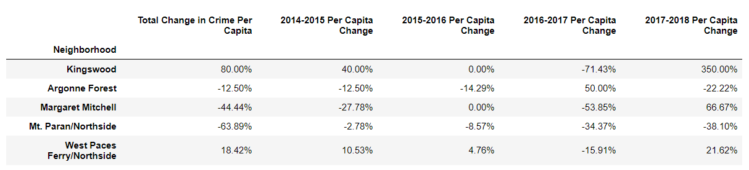
SUMMARY TABLE FOR TOP 5 MOST EXPENSIVE NEIGHBORHOODS
Notes:
Data Analysis
Discuss the steps you took to analyze the data and answer each question you asked in your proposal
Present and discuss interesting figures developed during analysis, ideally with the help of Jupyter Notebook

Slide 13
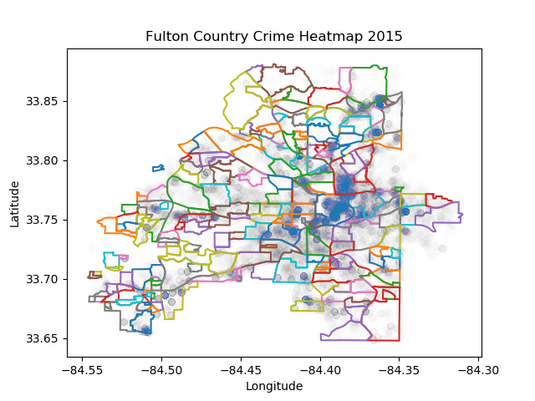

HEAT MAPS
Notes:
Data Analysis
Discuss the steps you took to analyze the data and answer each question you asked in your proposal
Present and discuss interesting figures developed during analysis, ideally with the help of Jupyter Notebook

Slide 14
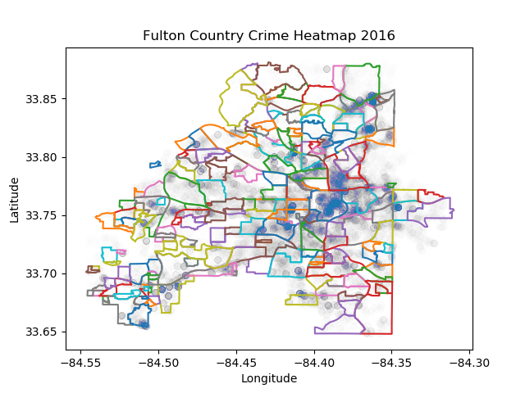
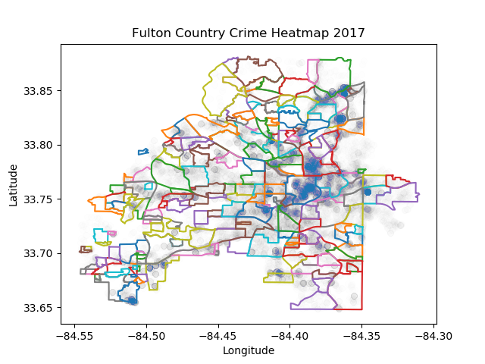
HEAT MAPS
Notes:
Data Analysis
Discuss the steps you took to analyze the data and answer each question you asked in your proposal
Present and discuss interesting figures developed during analysis, ideally with the help of Jupyter Notebook

Slide 15
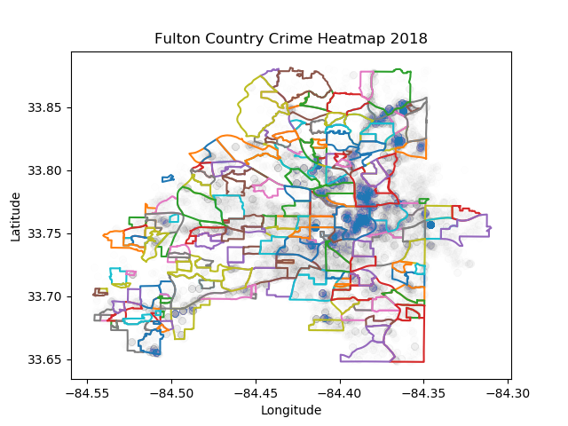
2014 HEAT MAP VS. 2018 HEAT MAP
Notes:
Data Analysis
Discuss the steps you took to analyze the data and answer each question you asked in your proposal
Present and discuss interesting figures developed during analysis, ideally with the help of Jupyter Notebook

Slide 16
OUR FINDINGS & POST MORTEM
Our Findings
Significantly more crime per capita in neighborhoods with lowest Median Home Values
Downward trend in crime per capita among neighborhoods with lowest Median Home Values
Neighborhoods with highest Median Home Values had significantly lower crime rates than average with no consistent trend upwards or downwards
In a Perfect World
Compare trends to trends if we’d had year over year Home Value data from Zillow
Better Census Data for each year we were analyzing
Linear Regression to see if we could estimate crime per capita based on home values
Notes:
Discussion
Discuss your findings. Did you find what you expected to find? If not, why not? What inferences or general conclusions can you draw from your analysis?
Post Mortem
Discuss any difficulties that arose, and how you dealt with them
Discuss any additional questions that came up, but which you didn't have time to answer: What would you research next, if you had two more weeks?

Slide 17

QUESTIONS & ANSWERS
Notes:
Questions
Open-floor Q&A with the audience

